Slide 1
Moss Hall Schools Federation Early Career Teacher Recruitment Pack, May 2024
Moss Hall Infant School is federated with Moss Hall Junior School. Together we are known as the Moss Hall Schools Federation.
Notes:
Notes -
need s infant information
Infant pictures
Much more pictures and information about
MHSA etc
Look at the ECT packs from

Slide 2
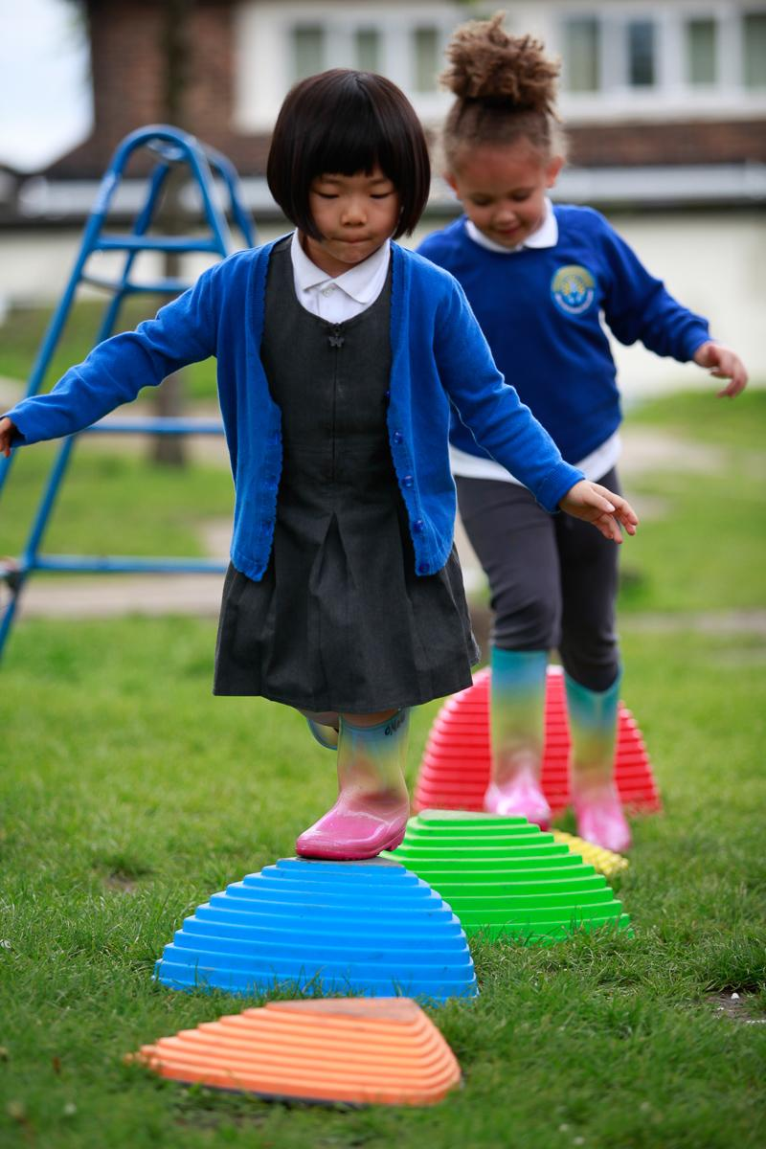
Welcome from our co-chairs of governors
Dear Applicant
Thank you for showing an interest in beginning your teaching career within our federation.
The governors, staﬀ and parents truly believe our schools are wonderful, supportive and friendly places to work and grow professionally. Our infant and junior schools have their own unique character and working in the federation allows for growth, vast experience and support as you develop your career.
Our children are curious, friendly, engaged and extremely well-behaved, supported by a parent community determined to ensure they all achieve to the best of their ability. Our schools federated in 2020 and we are thrilled by the hugely positive impact working together has provided in the development of our ambitious, diverse curriculum, teaching and leadership development, pastoral provision and overall ambition for all our children from Reception to Year 6.
Our staff are experienced, highly collegiate and supportive of each other and you will see how much they think of our schools later in this pack. They have worked together to develop and embed our ethos known as the The Moss Hall Way.
Our mantra of Be Kind - Work Hard - Make a difference runs through all that we do.
The warmth and high trust that exists in the schools and the ambition the whole team has to keep on improving makes it an exciting time to join us.
Mo Choonara & David Dunn, Co-Chairs of Governors

Slide 3
About us – our schools
The Moss Hall infant and Junior schools are both 4-forms of entry and are well located in a residential area with the luxury of extensive outdoor space. Both schools are diverse and truly inclusive communities with a higher than average percentage of EAL children. Our children are kind, polite, very well-behaved and excited learners with supportive parents and a wonderfully proactive Parent & Staff association (MHSA) .
The schools have been federated since January 2020 and most children transfer from the infants to the juniors. With one governing board, we think of ourselves as one school with a single vision, curriculum sequenced from Reception to Year 6 and with shared staff, policies, ways of working and development priorities. We work closely with Moss Hall Nursery which is adjacent to our schools.
We have easy access to the Northern Line (West Finchley) which enables us to maximise opportunities for educational visits and enrichment activities, bringing real life learning opportunities. Other transport links are excellent; there is free off-street parking in the local area.
There is a strong reputation for music, performance and PE across our schools. In addition our on-site swimming pool is an asset that the children are incredibly proud of. The arts and the environment are at the heart of the curriculum we are building.
Our curriculum is underpinned by cognitive science, informed by our community make-up and vision to develop kind, hard working children equipped with the knowledge and skills to be good citizens and make a difference.
A major strength of the schools is the high challenge/ low threat workplace environment created and sustained by all leaders. Honest high quality relationships underpin our work and will enable us to keep on improving. We are looking to recruit reflective, ambitious teachers with a clear moral purpose in entering this highly rewarding and important career. Leaders ensure all staff work smartly in a culture of growth for all.

Slide 4
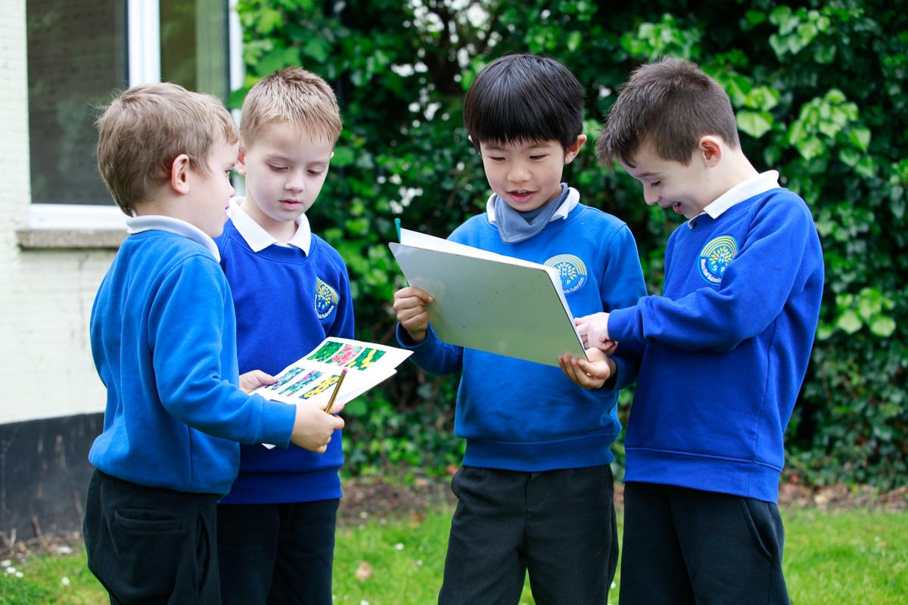
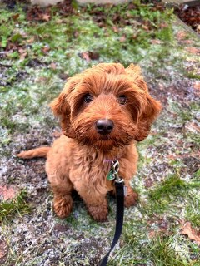
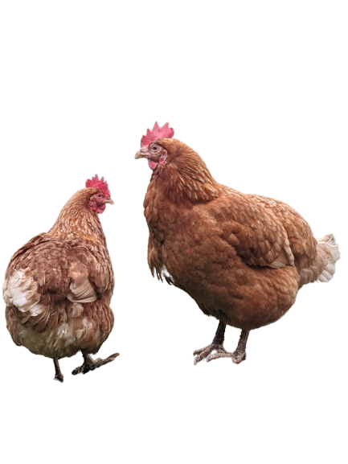
Your Career
We have successfully partnered with Ambition Institute as our Early Career Framework provider. We have successfully trained 12 Early career teachers since the beginning of the ECF. Our dedicated lead tutor and expert teacher mentors ensure all our ECTS have a very high standard of support and development. All but one of these colleagues have remained with us and are becoming mentors themselves. One of the 12 left to have a child and moved out of London.
We have chosen Ambition Institute due to its commitment to research informed adult learning and it’s refreshing approaches to continuous professional development.
We welcome applicants from ECTs who are interested in cognitive science and the science of learning, direct instruction, the work of Barak Rosenshine, Daniel Willingham and who follow blogs or maybe educational Twitter in order to keep updated and who are professionally curious. We will discuss this if you are selected for interview.
Applicants who have an interest in specific subject areas are encouraged to tell us about this too, as you will shadow a curriculum subject champion in order to develop curriculum expertise as part of their ongoing learning and development.
Your career will be carefully mentored by an experienced colleague. Coaching and mentoring is an embedded structure for all staff in our schools and seen as a key driver for teaching and leadership development and school led self improvement. As a large organisation the opportunity to plan alongside colleagues, observe the practice of others and to experience teaching across the whole primary range make a different to everyone . You will see from our website that we have highly developed systems to make sure we are efficient and think very carefully about helping colleagues manage their workloads.
We would encourage you to visit our website and browse through our curriculum pages and weekly newsletters to get a true flavour of our ambition and the breadth of our offer to our children and to get a sense of our warm and welcoming Moss Hall family https://www.mosshall.school/parents/

Slide 5
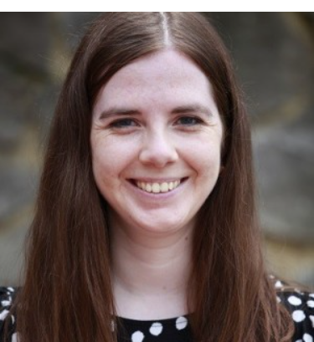
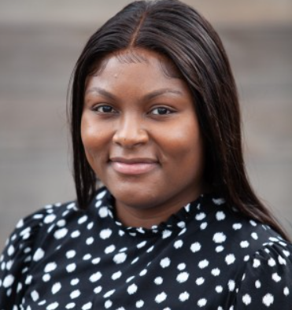
Why work at Moss Hall?
Moss Hall Junior School has been a warm and welcoming environment to be a part of, ever since my very first induction day. It is noticeable how friendly all staff are and I am constantly struck by how supportive a community it is. Senior leaders, mentors and year group leaders have all been available for advice, support and a listening ear and have helped me grow as a teacher during my first and second ECT year.
As a school, the teaching practice is rooted in pedagogical research and I have enjoyed developing my practice alongside more experienced teachers as part of our CPD sessions. It has been wonderful to feel part of the MHSF community and I would strongly encourage potential ECTs to apply!
Before starting my ECT year, I was incredibly nervous, especially during the summer counting down the days to September. I felt anxious about so many things such as; How will I know what to do? What if I mess up? All of these things kept playing on my mind constantly.
My worries and fear quickly disappeared once I started, everyone was incredibly helpful, kind and supportive.
Being in a larger school has been great, I have met so many amazing individuals, each of whom are on different stages of their career, this I believe is what makes working in a four form school, such as Moss Hall so great, as we all come together as one and make amazing things happen.
I feel lucky to have found a school where I feel valued, supported and happy.
Notes:
Jenny and Veesha - message
Tonique and Rowena

Slide 6
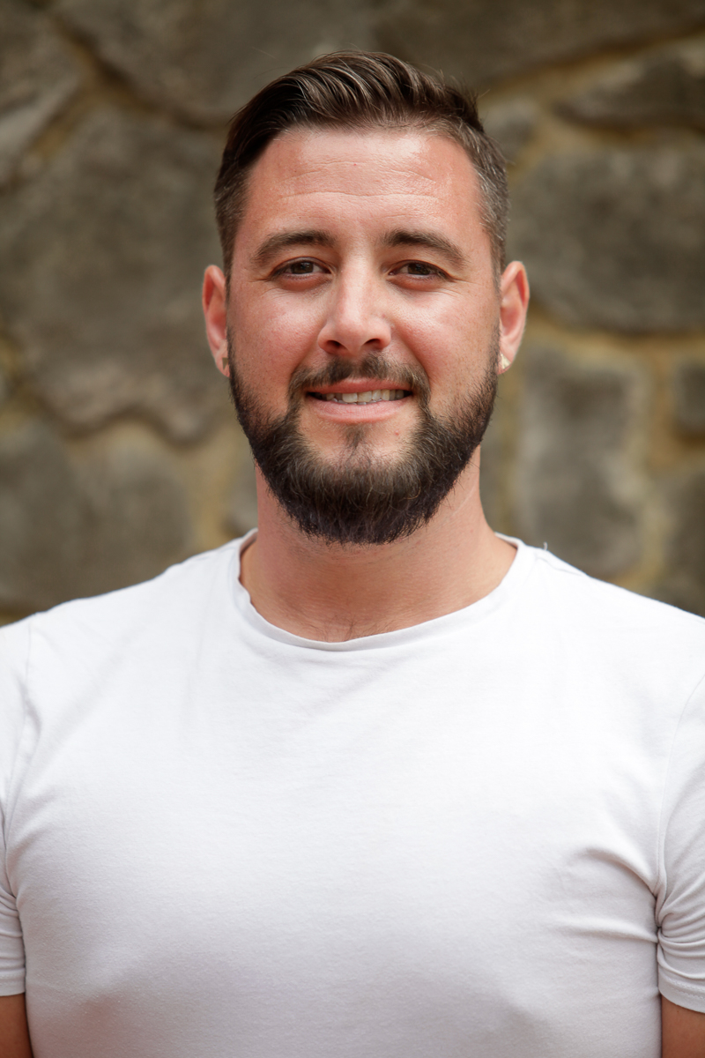
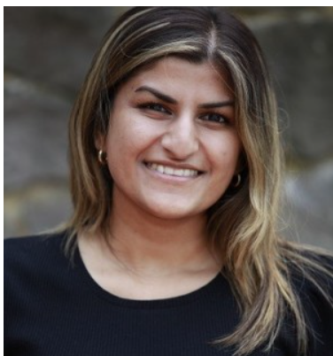
Why work at Moss Hall?
I love being a member of the Moss Hall team. Our community of staff have always been supportive, cohesive, hard-working and fun to work with. I feel very lucky to be in an environment where I am encouraged to take part in education research in order to try new things out in the classroom and develop my practice as a class teacher. I have been supported and encouraged as a leader at every step and feel now, more than ever, that I am part of a team that is shaping the way we have an impact on our children as a school community.
MHJS is an incredible school to work at and I don't intend on leaving. I've been here for 9 years, where I have and continue to have opportunities to improve my skills as a teacher and work as part of a positive, supportive and welcoming team - truly one of the friendliest staff communities I've ever worked with. When I arrived at MHJS I was a classroom teacher, and now, I am a classroom teacher and Year Group leader for Year 6, mentor to students and staff and I am still learning and developing my pedagogical practice. I would recommend MHSF to any new or experienced teacher.
​"I completed my ECT training at Moss Hall last year and am currently in Year 6 at Moss Hall Junior school. I have really enjoyed my training here and felt very supported by all staff at MHJS while starting my career and the ECT programme.
Due to the large scale of the school, there are many opportunities for guidance from lots of staff. I have benefited from having an amazing team of teachers in my year group to work collaboratively with and guide me.
My experience thus far has allowed me to continue to develop my teaching practice and grow in confidence in a nurturing setting. The environment at Moss Hall is positive and inspiring, which is evident with the children and their positive attitude towards attending school and learning.
I would recommend this Moss Hall Federation to any ECT or teacher who wants to work in a collegial environment and enjoy coming to work everyday
- like me!"
Notes:
Jenny and Veesha - message
Tonique and Rowena

Slide 7
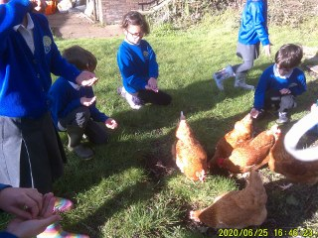
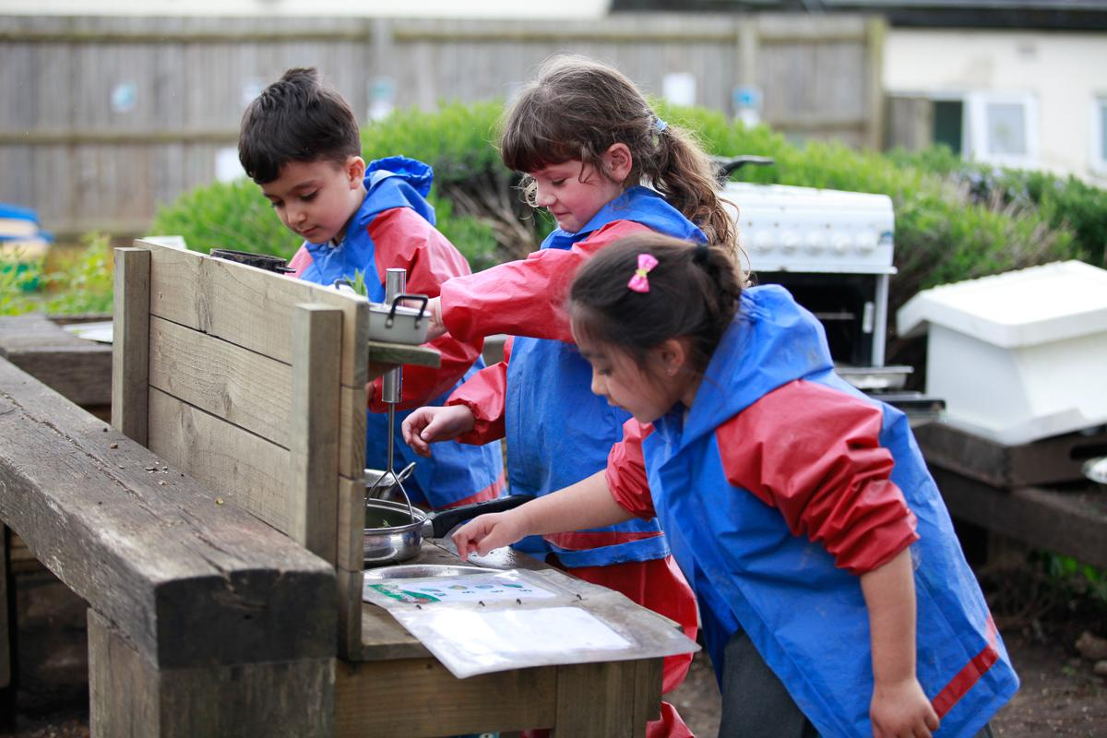
How to apply
Moss Hall is actively recruiting for 2 ECTS starting in September 2024.
Alongside this document you will find the detailed job description and personal specification.
Talking to someone from the school before you apply is very important to explore our ethos, to find out what makes Moss Hall special and how you might fit into that culture.
We would strongly advise that you book a phone/ virtual or physical appointment with one of our senior staff to talk through the role and come and see us in action if you can.
Please book by calling Haleh Honarzad on 0208 445 9735 ext. 1201
Applications are made on the Barnet Teaching application form. CVs are not accepted. Your personal statement as part of this form, should be no more than 2 sides of A4, font size no smaller than pt 11. The recruitment information document on our website gives more information about our processes. Link to application form: https://docs.google.com/document/d/1Vnbmqx34ozMNrf7lSI90CTXAeQm3L0zo/edit?usp=sharing&ouid=115424057034350561051&rtpof=true&sd=true
Your full application can either be returned by email for the attention of The Executive Head via Haleh Honarzad at recruitment@mhi.org.uk
Applications close on 29th May 2024 (half term). Interviews will be on 10th June in person.
If selected for interview - this will involve a lesson observation, coaching conversation and interview. We share most of the interview questions with candidates prior to interview so you can fully prepare.
Good Luck!

Slide 8
Characteristics of our 2 Federation schools
 | Moss Hall Infant School | Moss Hall Junior School
School type | Maintained | Maintained
Number of Children | 316 | 443
Forms of entry | 4 (3 in current Reception) | 4 (3 in current Year 6)
% PPG | 15.2% | 20.1%
% EHCP | 3.5% | 3.6%
% SEN support | 11.9% | 12 %
% EAL | 69.9% | 68.2%
Ofsted rating | Good + Outstanding EYFS and Personal Development (2023) | Good (2022)

