Slide 1

Welcome to Moss Hall
Infant School
An introduction for families new to Reception in September 2022
Part of Moss Hall Schools Federation

Slide 2
Our purpose this evening
To introduce you to our federation of schools
To introduce you to key staff in our Infant school and Federation
To share our curriculum intent and aims for the Early Years
To give you a sense of a typical day in Reception
To explain how we communicate and work in partnership with you
To explain our settling-in processes and give you some key dates

Slide 3

Welcome to our Federation

Slide 4
Our Federation Goals 2020-25
Our schools are beautiful and safe places for children to learn and thrive within
We are at the centre of our community
We are a centre of excellence for staff development and well being
We are a centre of excellence for Early Years Education
We are a centre of excellence for SEND/ Inclusion
We innovate and adapt our curriculum to reflect our diverse community
We demonstrate excellence across the arts including Music/ PE and Art

Slide 5
Our priorities in order to achieve our goals:
Raised standards for all
Professional learning and leadership development
Evidence driven pedagogy
An ambitious curriculum
Effective, timely communication
Every child seen, known and safe

Slide 6
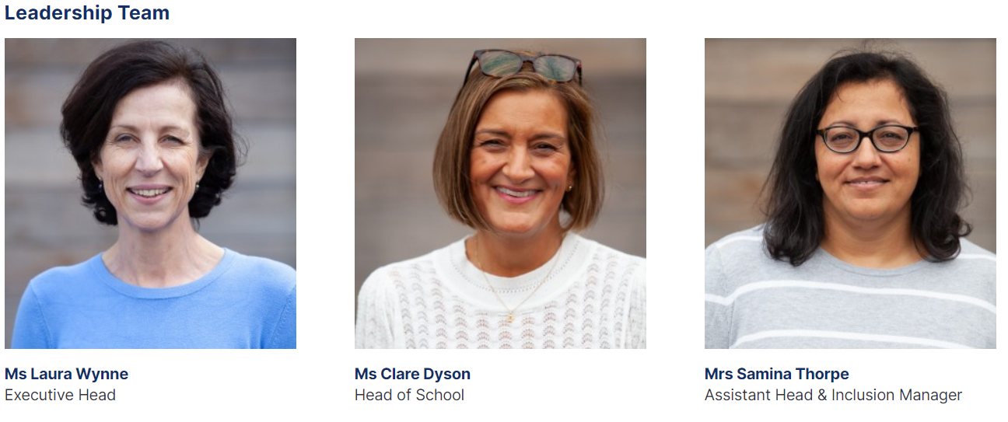
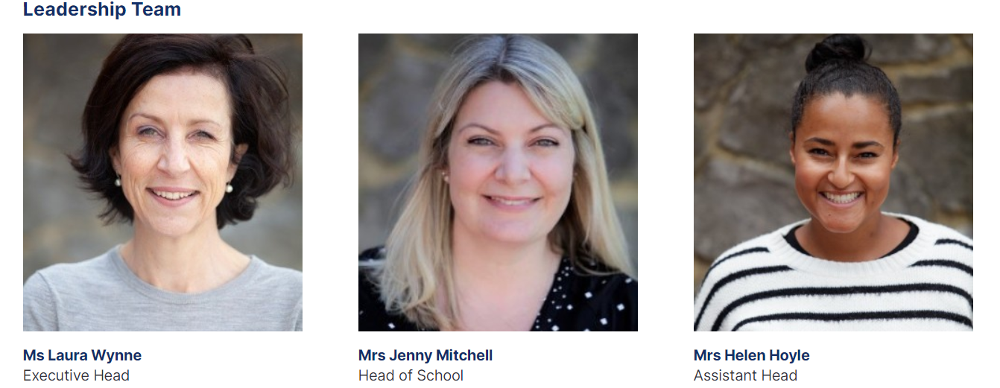
Who is who at MHIS?
The Headship team at
Moss Hall Juniors

Slide 7
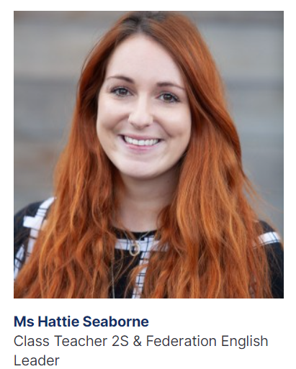
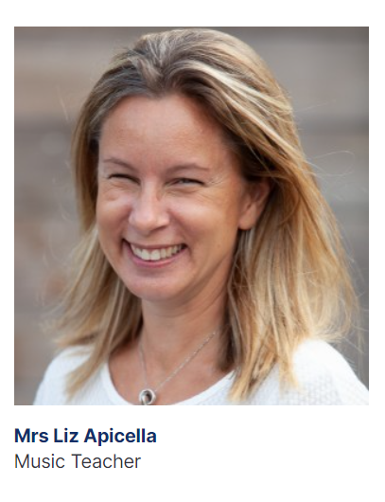
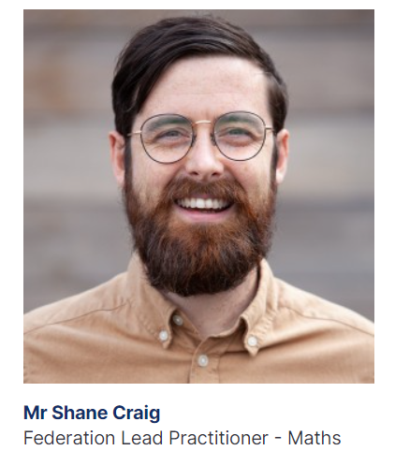
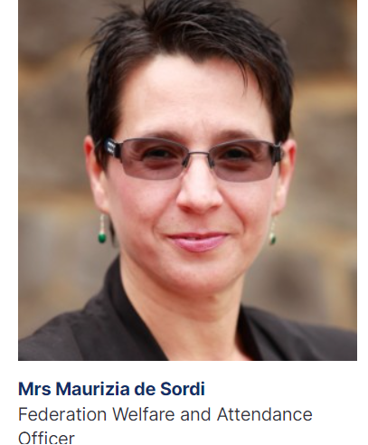
As a federation many staff work across both schools.

Slide 8
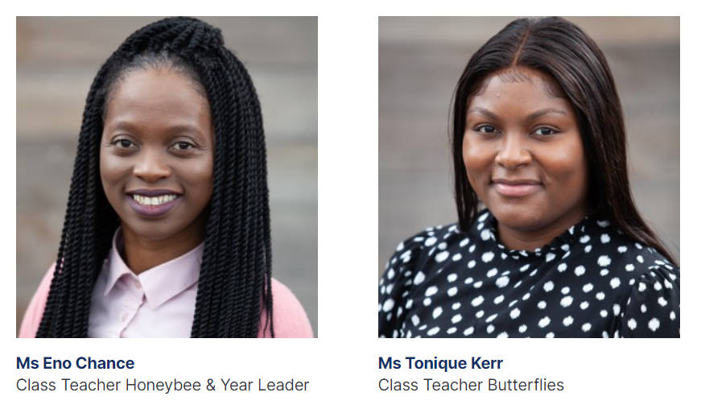
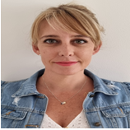

The Reception Year Group team
Mrs Melanie Yankelowitz
Ms Hollie Clifft

Slide 9
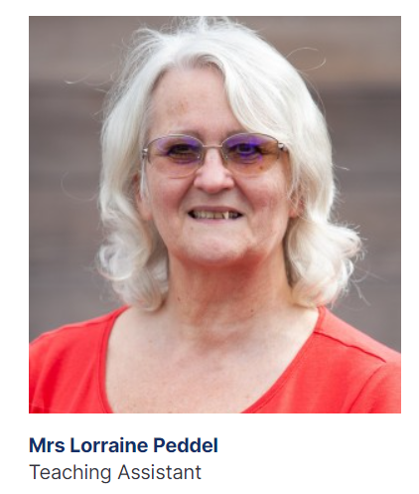
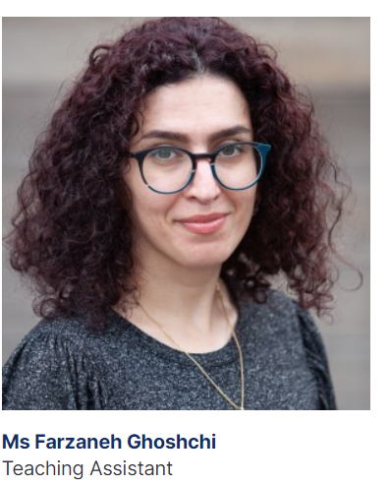
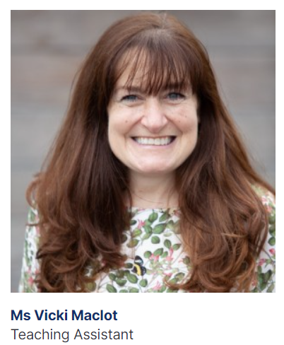
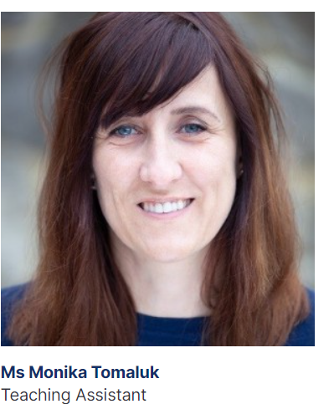
The Reception Year team support staff

Slide 10






Where do we start with our curriculum in our Early Years?

Slide 11
Our Curriculum
Children in Reception follow the Early Years Foundation Stage Curriculum. Which consists of 7 different areas of learning.
We value every child as a unique individual, who enjoys learning and thinking for themselves.
We aim to provide an engaging, safe and stimulating environment which allows children to feel happy, secure and valued and therefore ready and eager to learn.
Our role is to stimulate and encourage children’s development and enjoyment of learning through a wide range of activities, both indoors and outdoors and both child-led and adult-directed.
Our Curriculum
Learning together, making a difference
Children in Reception follow the Early Years Foundation Stage Curriculum. Which consists of 7 different areas of learning.
We value every child as a unique individual, who enjoys learning and thinking for themselves. We aim to provide an engaging, safe and stimulating environment which allows children to feel happy, secure and valued and therefore ready and eager to learn. Our role is stimulate and encourage children’s development and enjoyment of learning through a wide range of activities, both indoors and outdoors and both child directed and adult directed.

Slide 12
Our Curriculum
Is rooted in talk, reasoning and development of the language for thinking
Is built around diverse children’s literature
Is sequenced so that children's knowledge is built on their own prior knowledge
Focuses on developing a readiness for reading and writing through learning phonics AND to love to linger with books
Will celebrate and develop children’s early mathematical understanding and build on this
Links seamlessly with Year 1 and beyond - so children meet concepts of sustainability, diversity, community amongst others several times as they move through the schools.

Slide 13
The School Day
8:50 School gate opens
8:50 9:05 Soft start
9:05 Register taken
9:10 Phonics
9:45 Child initiated / Adult directed learning- indoor and outdoor
11:05 Carpet session
11:20 Staggered lunchtime begins
12:30 Carpet session
1:05 Child initiated / Adult directed learning - indoor and outdoor
2:35 Tidy up
3:15 ​Home time​

Slide 14
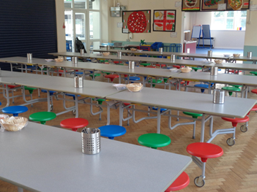
School lunches
All infant aged children are entitled to a free school meal.
The Pantry is the schools meal provider. You will be asked to set up an account on The Pantry platform for your child.
The Pantry provide hot cooked meals daily with a pre-ordering system for families to select daily menus -giving greater choice and control of their child's daily meal options. Food can be ordered ahead or on a daily basis provided all orders are made by 9.30 am. We encourage you to pick food that your child is happy to eat so that lunch times are a positive experience.
The Pantry are able to cater for a number of dietary requirements.
We encourage all of you to start your child on school meals.
Packed lunches preferences can be discussed.
More information on how to contact The Pantry can be found on our website using the link below.
https://www.mosshall.school/parents/school-meal-menu/

Slide 15

SEN/ Inclusion
Mrs Thorpe has particular responsibility in the school for children with Special Educational Needs and/or Disability
We work as a team to make sure all children are making progress.
If you have any concerns about your child please talk to your class teacher or come and talk to Mrs Thorpe.
Regular workshops and parent training sessions are very well attended by all our parents and cover a range of Early childhood development matters.

Slide 16

Medical Needs
Mrs Thorpe and Mrs De Sordi manage the medical needs of all children in the Infant School.
We also have over 13 Paediatric First Aiders in the school.
If your child has medical needs or allergies we must be informed so we can support them fully in school.
We can administer medication for a long term condition though not antibiotics or other short term treatment.

Slide 17
How we communicate with you
We send out communication via Tapestry, email , School Ping and via our website
If you have a query, please speak to the teacher at the end of the day (once the children have been dismissed) or call the office and the staff will get back to you. We aim to respond to most matters swiftly. Never approach other parents if you have a problem with another child.
What is Tapestry ?
  An online journal
  A reception overview about the learning the children have done is sent via Tapestry.
  Responding to homework
The school’s weekly newsletter often highlights news and upcoming dates of interest

Slide 18
Preparing the children for Reception
We have made contact with many nursery providers
Transition books (paper copies) in place for some children and e-transition books made available on the school website for each class.
School visit in July and September
Complete the ‘All About Me’ booklet
Please share any ’End of Year’ reports with your new teacher
‘Meet the Teacher’ meeting in September

Slide 19





Developing independence ready for school.
Can they go to the toilet by themselves?
Can they wash and dry their own hands and know when to?
Can they blow their nose and throw away the tissue?
Can they eat independently with cutlery/ utensils?
Can they recognise and write their first name and recognise their own name on their uniform?
Can they ask for help?
Are they used to helping with small jobs at home/ nursery?
Can they count out objects and recognise numbers to 10

Slide 20

Uniform
Moss Hall Schools Federation has a simple, affordable uniform with a single logo that unifies the 2 schools
Reception children wear a named polo shirt and logo jumper and plain dark grey/ navy leggings / jogging trousers
Shoes must be Velcro fastening
All items must be named, including “spare” items the team ask you to provide.
These items are selected as they encourage independence and enable staff to focus on developing the whole child rather than supporting dressing and undressing. Children should not wear pinafores, skirts, tights UNTIL they can independently dress/ undress quickly
All children are asked to bring in a pair of wellington boots (named) to wear outside in the garden.

Slide 21
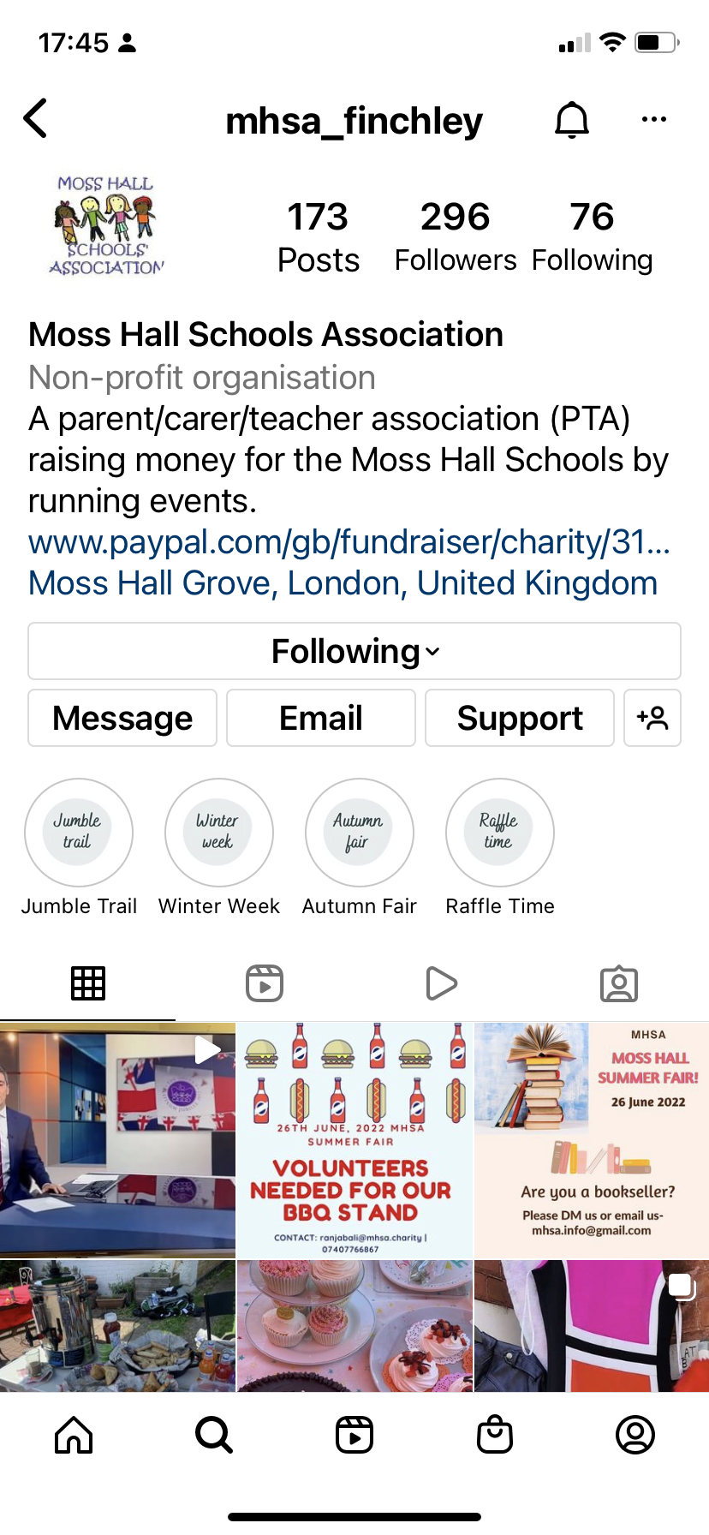
Moss Hall Schools Association (MHSA)
Who we are
What we do
Parent reps
How to get involved
https://www.mhsa.charity/
Join us at the Summer Fair: Sunday June 26th 12-4pm

Slide 22


Slide 23
Moss Hall Schools Association
Date for your diary
Friday 14thOctober 2022
Come and meet other Reception parents and the MHSA in the Garden at 3.15pm
Light refreshments and drinks served

Slide 24
What happens next?
Photo request: You will receive an email, on Monday 20th June, requesting a passport style photograph of your child to be sent to the school electronically.
Class group information: You will receive a letter with your child’s class group, start date and settling in information – 24th June 2022
Stay and Play: You will receive an invitation to meet your child’s teacher and see the school and classroom – 5th & 6th July
Before the end of the Summer term, you will receive a link to an e-transition book. Please support your child by regularly sharing the transition book with your child
Buy your child’s uniform
Prepare the ‘All about me’ booklet with your child – bring it in Sept
In September – attend the ‘Meet the teacher’ meeting with your child

Slide 25
Significant Dates
24th June class letters to new reception families, start date and cycle for own child.
5th and 6th July – Stay and Play sessions for new Reception by invitation - 45 mins - mornings
5th and 6th September – new Reception children visit (20 mins 1:1 with parent)

Slide 26
Significant dates - starting school
From Week 1 children start school in groups
This will start from 7th September 2022
Children start by doing a full day (unless they need a personalised plan by arrangement with you)
We start with a group of 10 children and add on 5 each day until all children are in by Friday 15th September
Once they are fully settled children may join the afterschool or breakfast clubs subject to places available

Slide 27
Your questions for us ..

