Slide 2
Registration
The following slides explain the registration process.

Slide 3
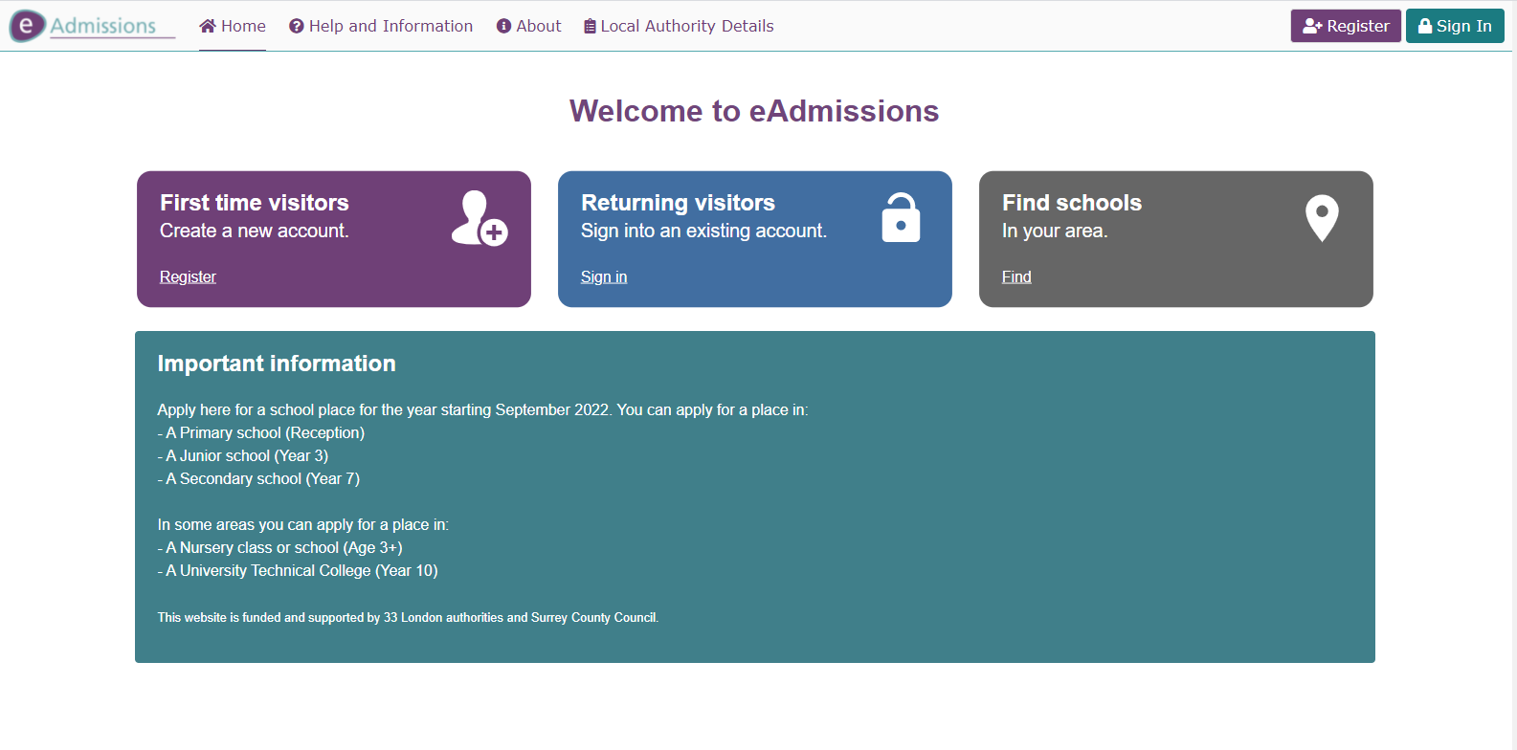
Registration 1
To register for an account to make an eAdmissions application, please first visit the website www.eadmissions.org.uk and then choose one of the options to “Register” on the home page.

Slide 4
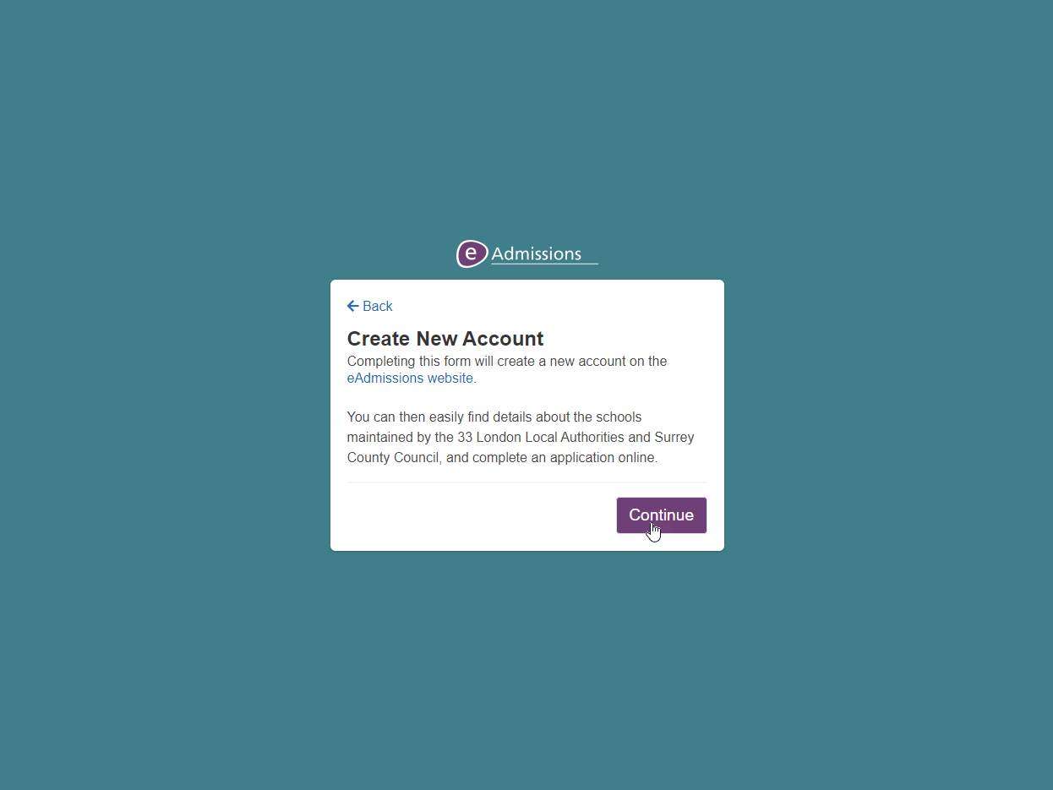
Registration 2
You will then be taken to the Registration section, where you will need to enter your details on the different screens that will appear.
Please click “Continue” on this page.

Slide 5
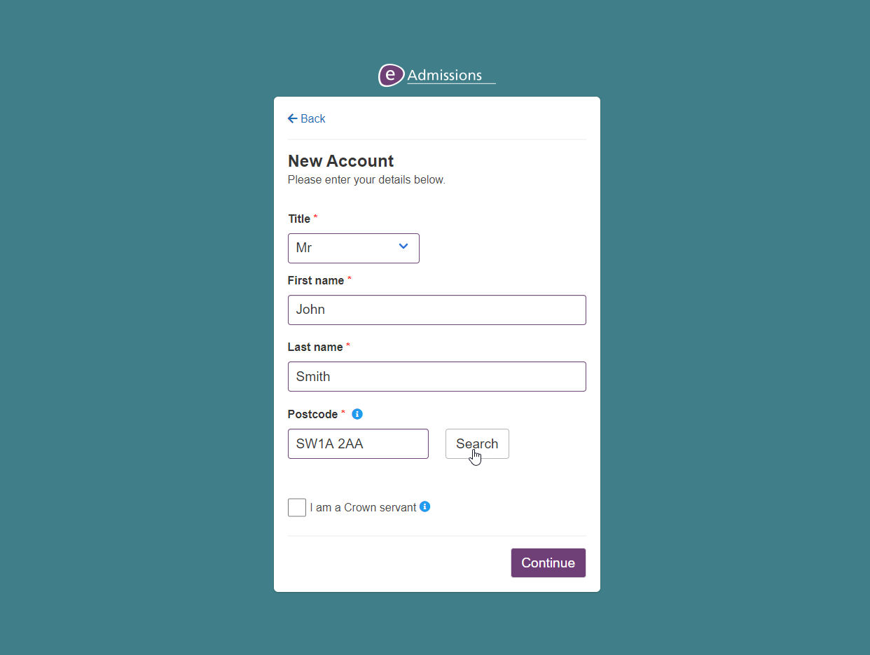
Registration 3
Please enter your Title, First name, Last name and Postcode. Once these have been entered, please click on the “Search” button to find your address.
If you need help with a particular question, please click on the “i” icon.

Slide 6
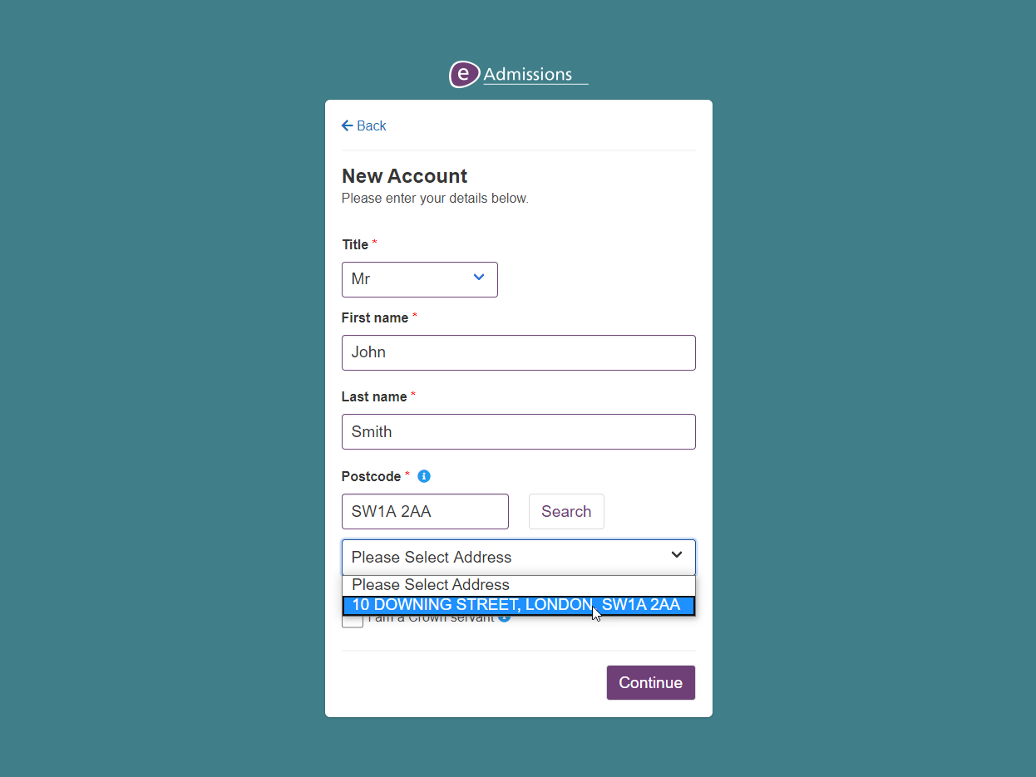
Registration 4
Please then select your address from the list that will appear.

Slide 7
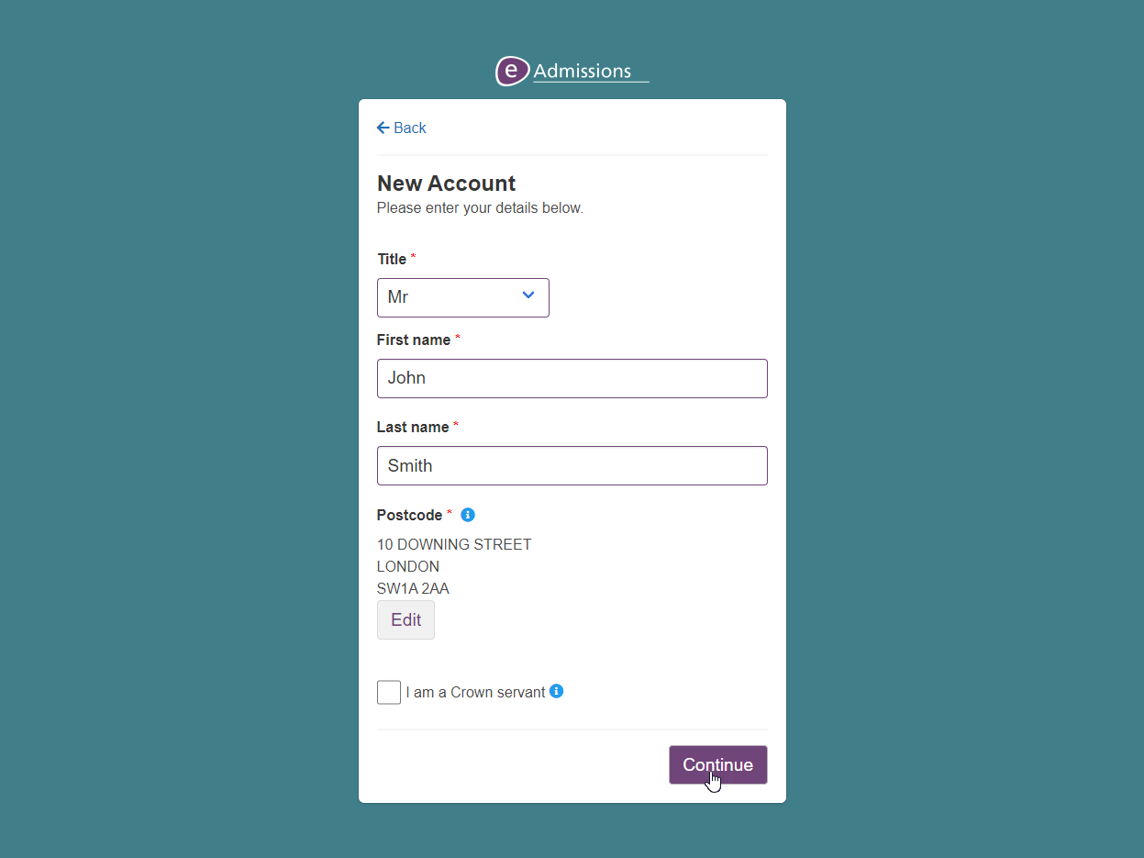
Registration 5
You address will now appear on the screen, and can be changed by clicking on the “Edit” button.
If you are a crown servant, please tick the “I am a Crown servant” box, otherwise click “Continue”.

Slide 8
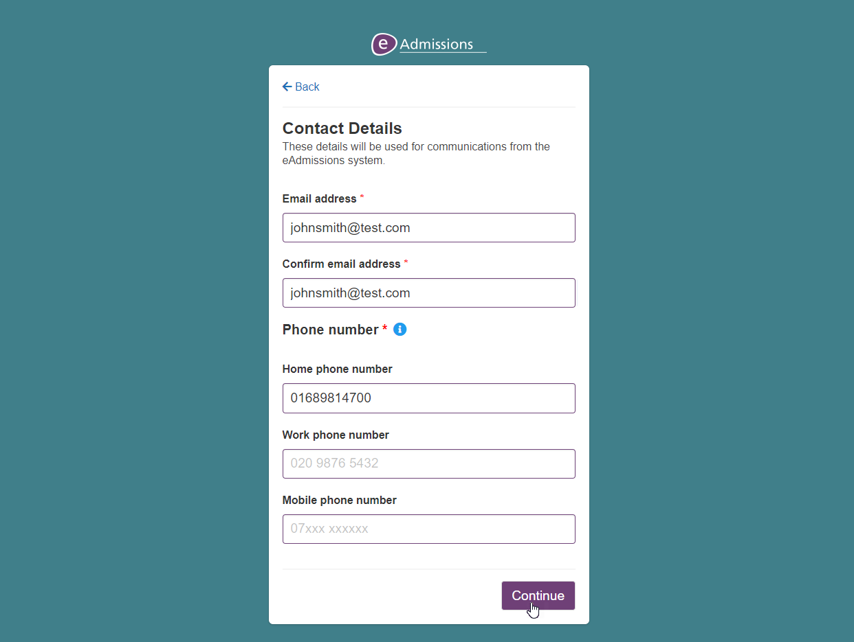
Registration 6
On this screen you will need to enter your contact details. Please enter your email address and at least one phone number before clicking “Continue”.

Slide 9
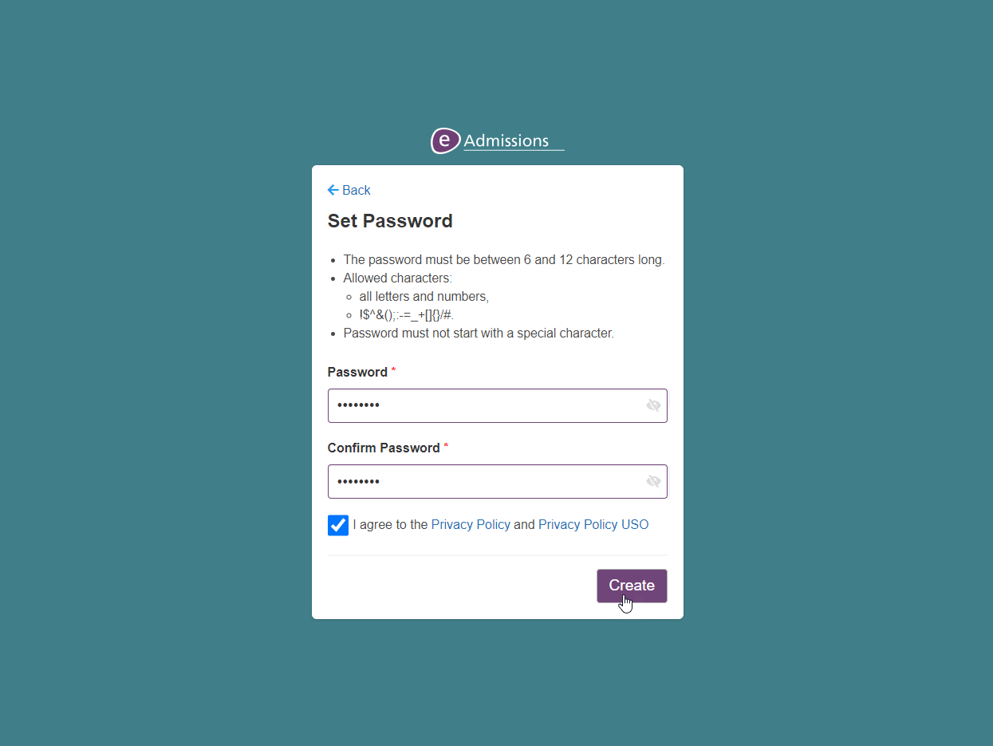
Registration 7
You will now need to choose the password for your eAdmissions account. Please enter it the password box and then re-enter in the box below. The password complexity rules are displayed at the top of the screen.
Once your password has been entered, please review the privacy policies before ticking the box and then clicking “Create”.

Slide 10
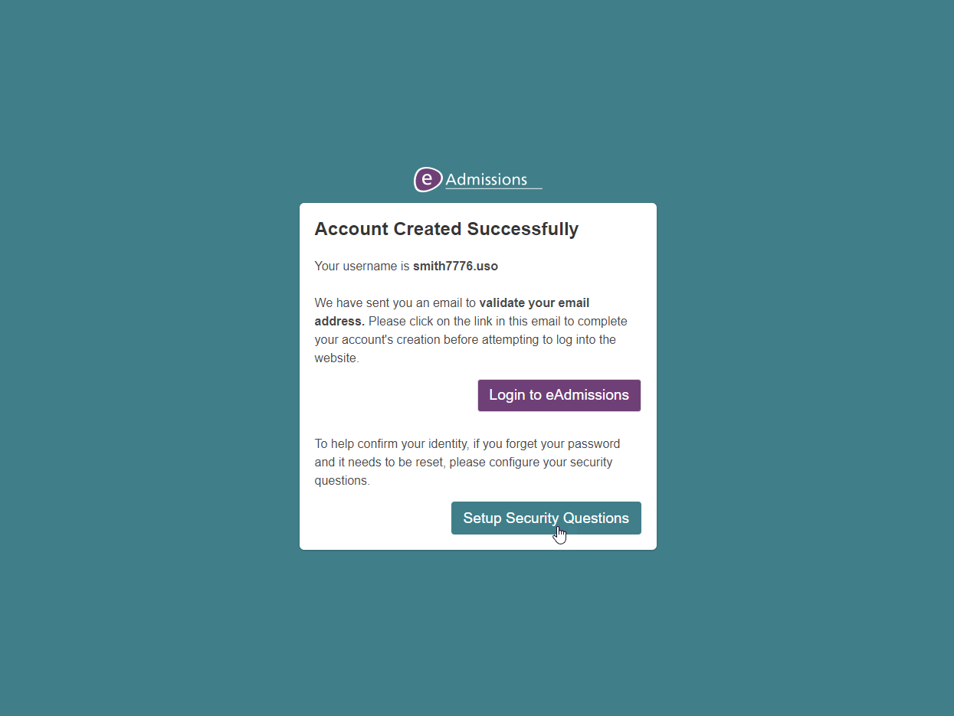
Registration 8
Your account has now been created and you will receive an email to the email address supplied with a link to validate your account. Please find this email and click on the link.
You can then choose whether to login to the eAdmissions website now or setup security questions for your account. In this tutorial we will be setting up the security questions.

Slide 11
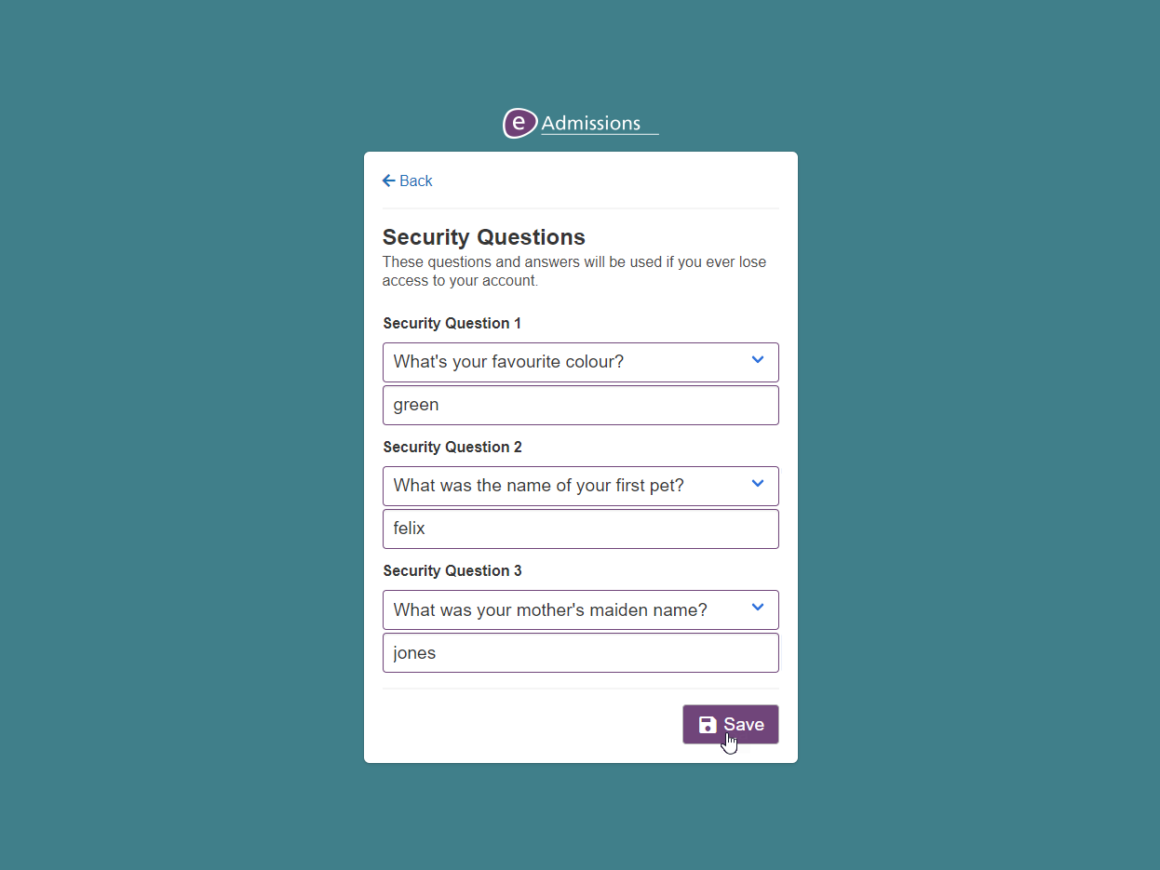
Registration 9
Please select your security questions and your answers. Once set, security questions can be used to recover access to your eAdmissions account.
Once the questions and answers have been entered, please click “Save”.

Slide 12
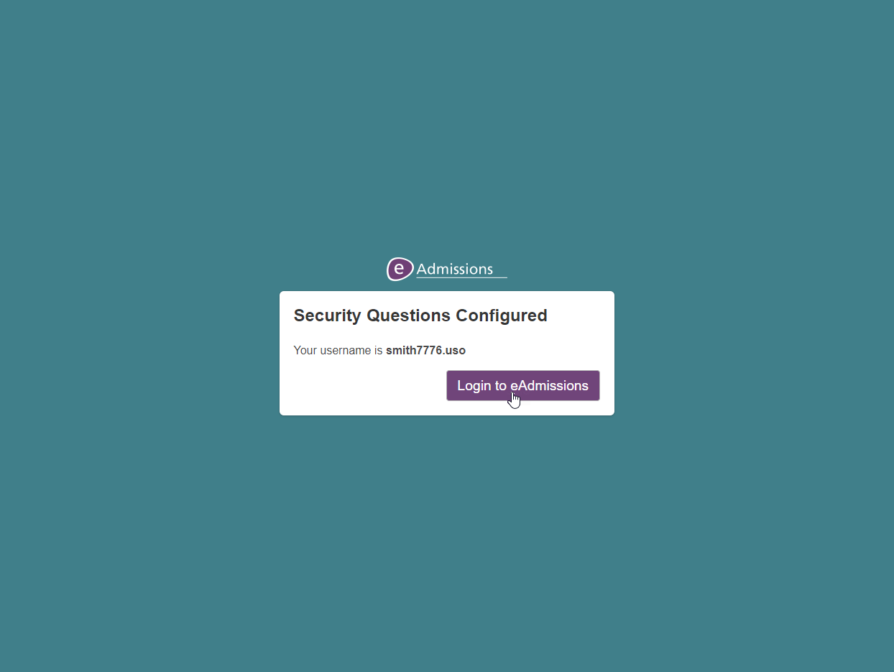
Registration 10
The security questions have been successfully entered, please click “Login to eAdmissions”.

Slide 13
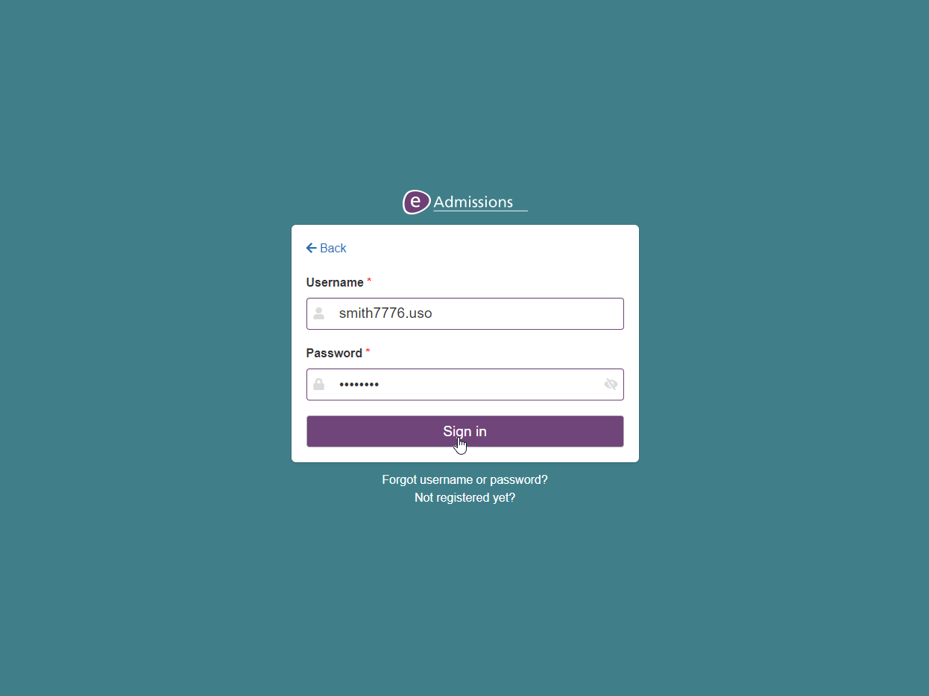
Registration 11
Your username will automatically be put in the username field for you and your password will need to be entered before clicking “Sign in”.
Please make a note of your credentials as you will need them to log into the website in the future.

Slide 14
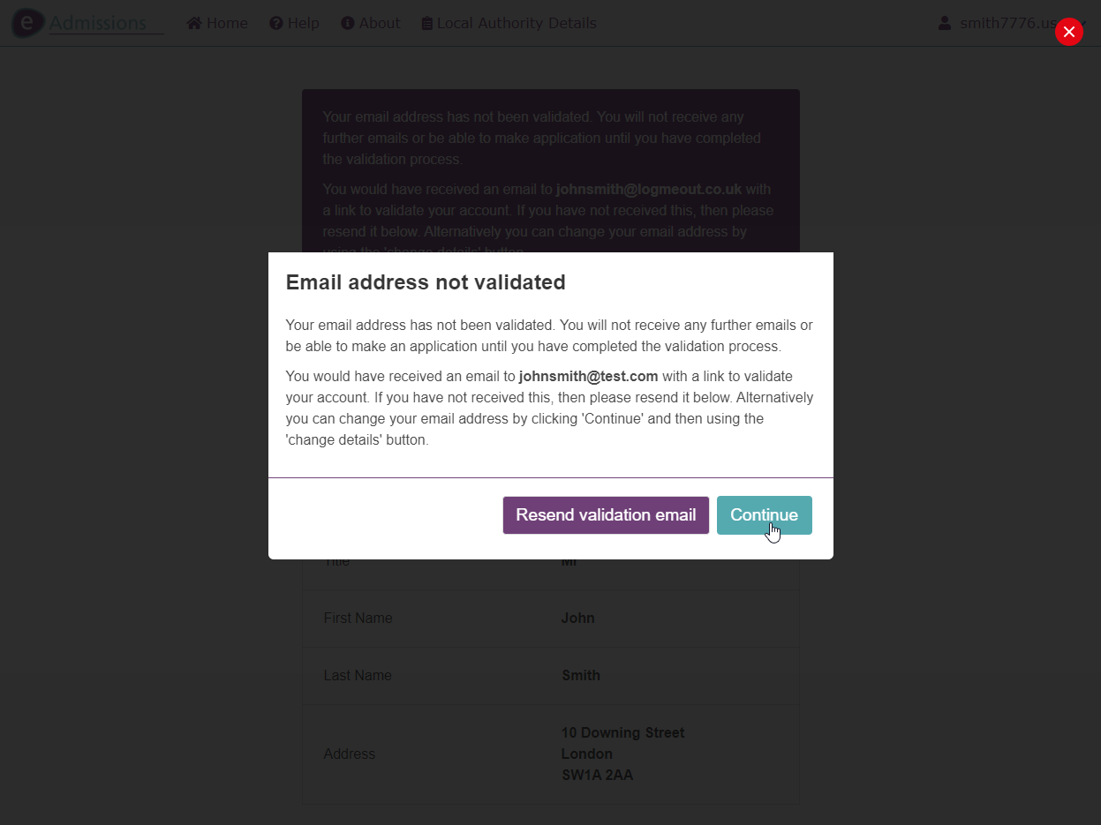
Registration 12
Upon logging in you will either be taken straight to your home page, if you have validated your account already, otherwise you will be taken to this screen that will ask you to validate your account.
If you have not validated your account yet, please now find the validation email that has been sent to you and click on the link to validate.
If the email hasn’t been received, you can click on the “Resend validation email” button.

Slide 15
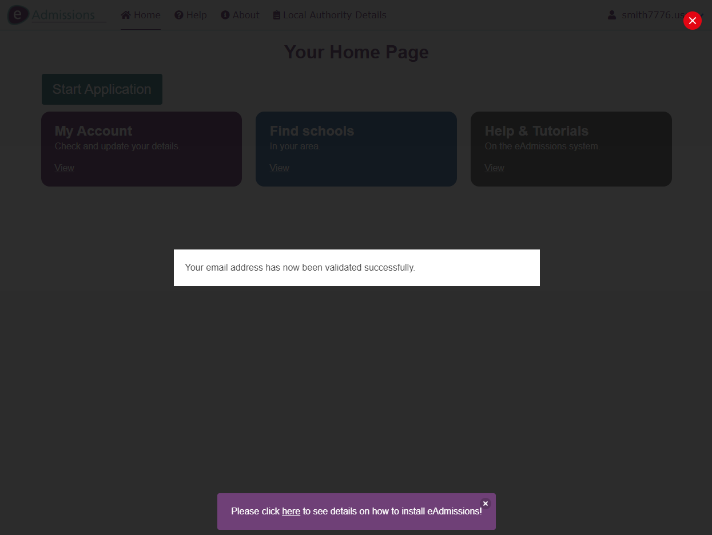
Registration 13
Upon clicking the validation link in your email, you will be informed that it has been validated successfully and will now be able to start an application.

Slide 16
Reset
The following slides explain the username & password reset process.

Slide 17
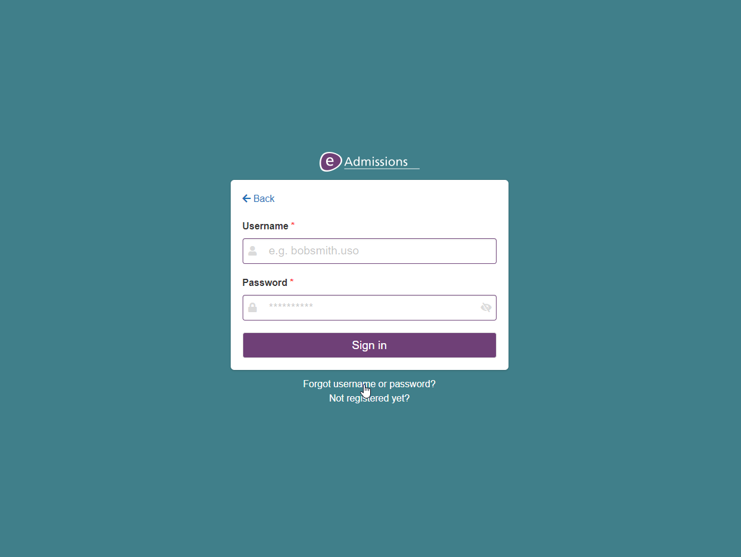
Reset 1
If you have forgotten your eAdmissions username and/or password, these can easily be reset. To do this first click on the “Forgotten username or password?” link on the login screen.

Slide 18
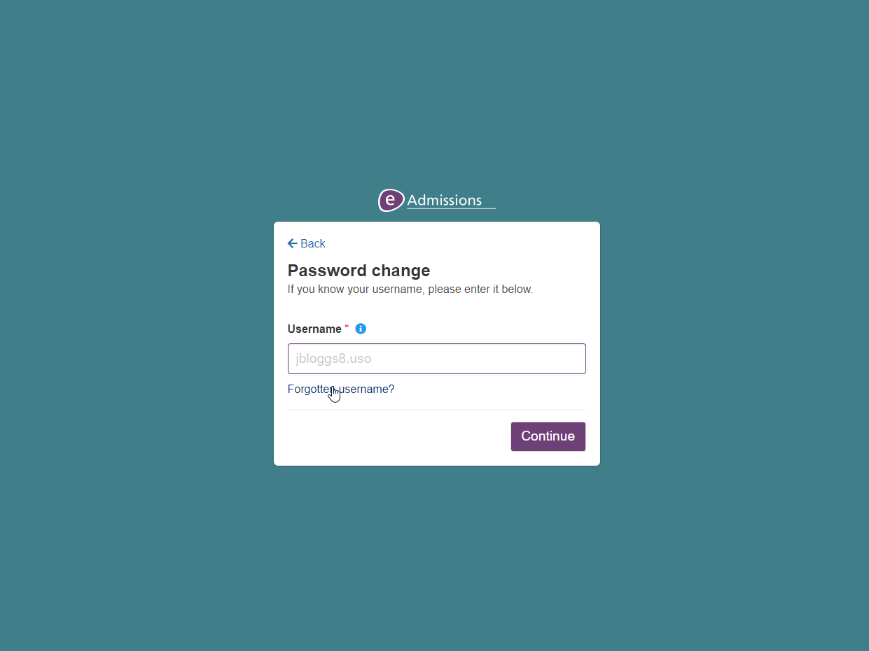
Reset 2
If you need to reset your password only, and know what your username is, you can enter your username in the box and then click “Continue”.
If you are not sure of what your username is, please click on the “Forgotten username?” link.
In this tutorial, we will recover the username and reset the password.

Slide 19
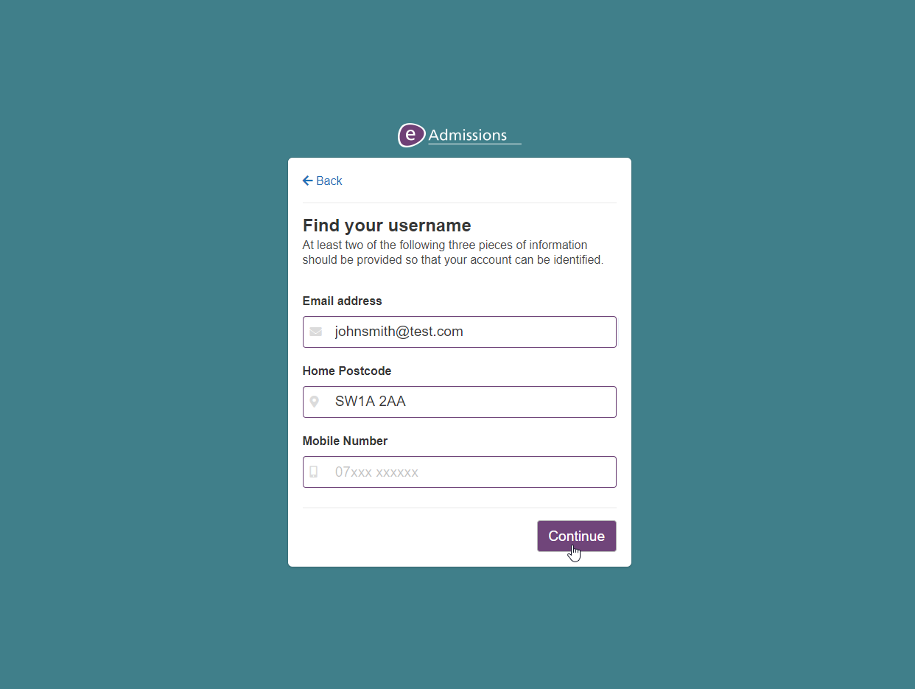
Reset 3
To recover your username, please enter your details on this screen. At least two pieces of information need to match your account for it to successfully provide your username.
Once your details have been entered, please click “Continue”.
If it is unable to find your username, please click the details you have entered before clicking “Continue” again.

Slide 20
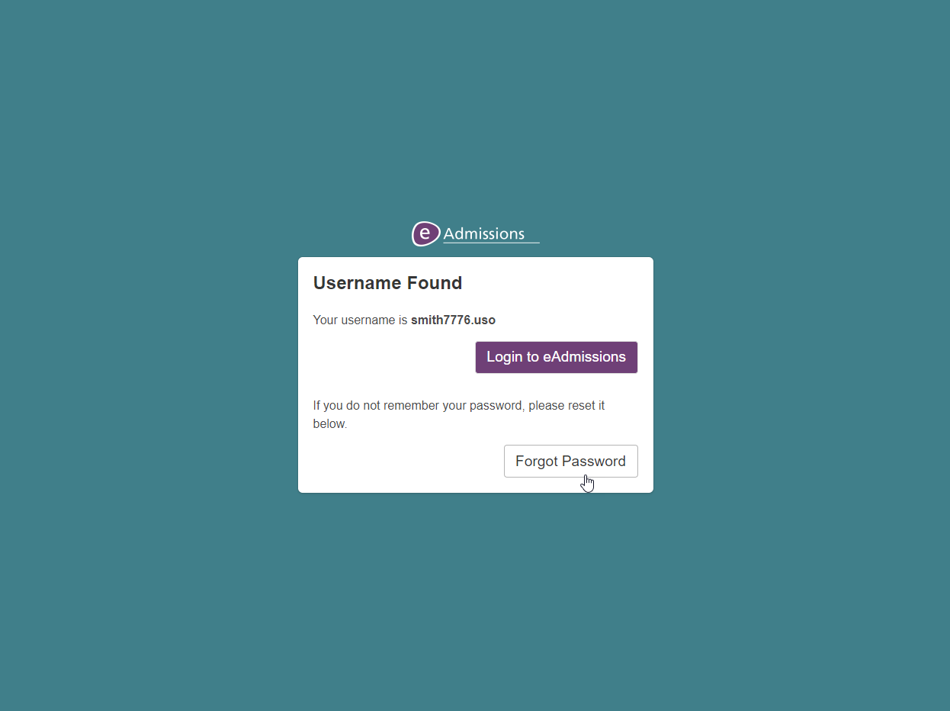
Reset 4
Your username should now be displayed on the screen.
If you know what your eAdmissions password is, you can click the “Login to eAdmissions” button otherwise click “Forgot Password”

Slide 21
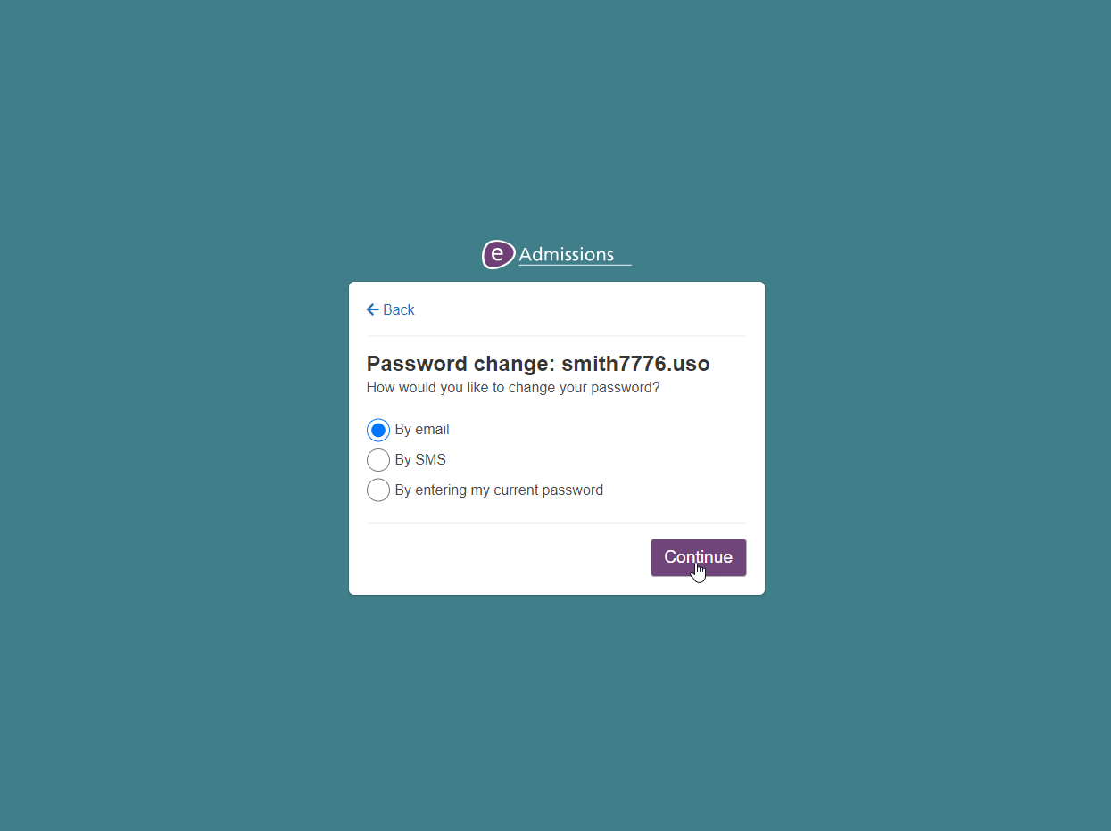
Reset 5
You now need to choose how you would like to reset your password. The different options available to your account will be displayed on the screen.
In this example we will reset the password by email, and so will click on “By email” and then “Continue”.

Slide 22
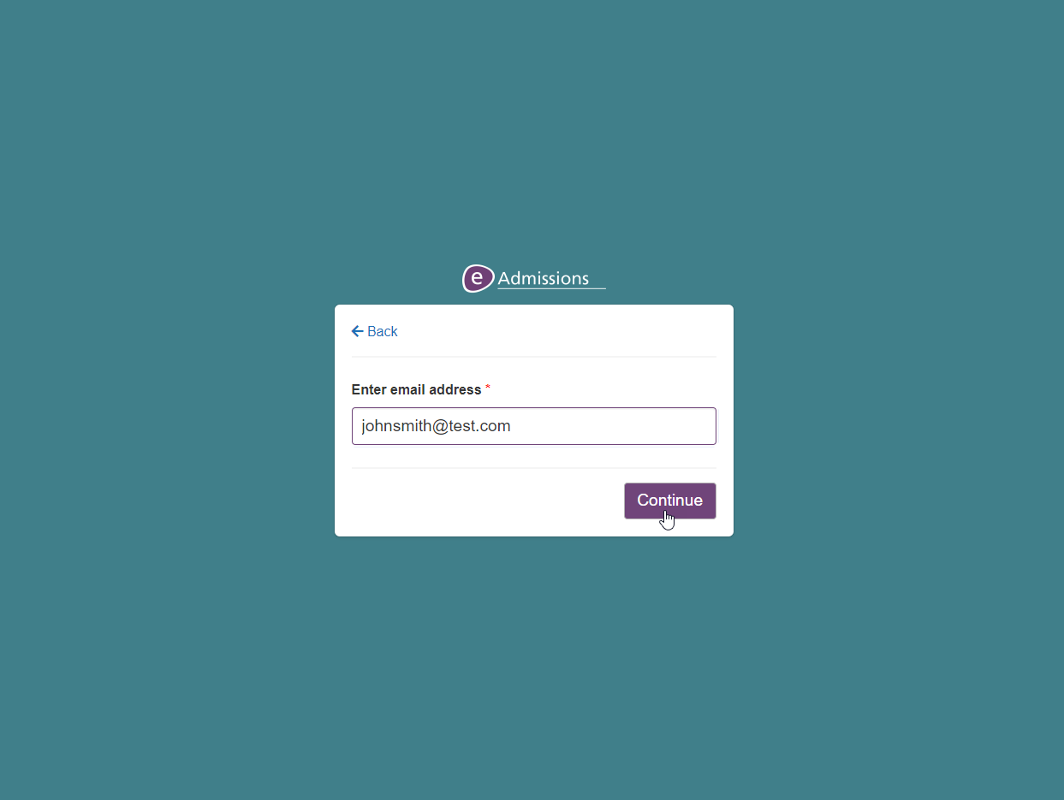
Reset 6
Please enter the email address on your account, or other information asked for if a different option has been selected on the previous step, and then click “Continue”.

Slide 23
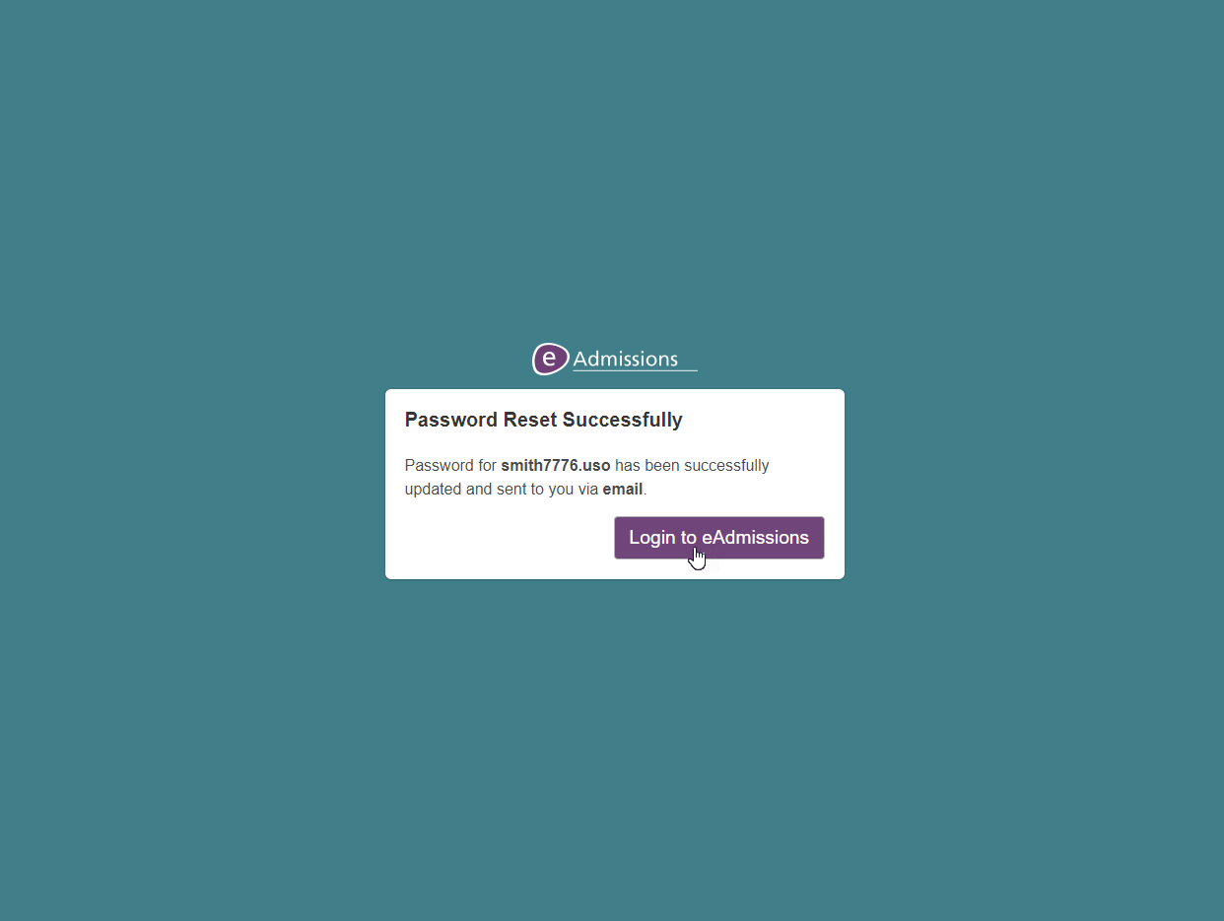
Reset 7
Your password will now be sent to you via email and you will be able to use it, along with your username, to log into your account.
Please click “Login to eAdmissions” to be taken to the login page.

Slide 24
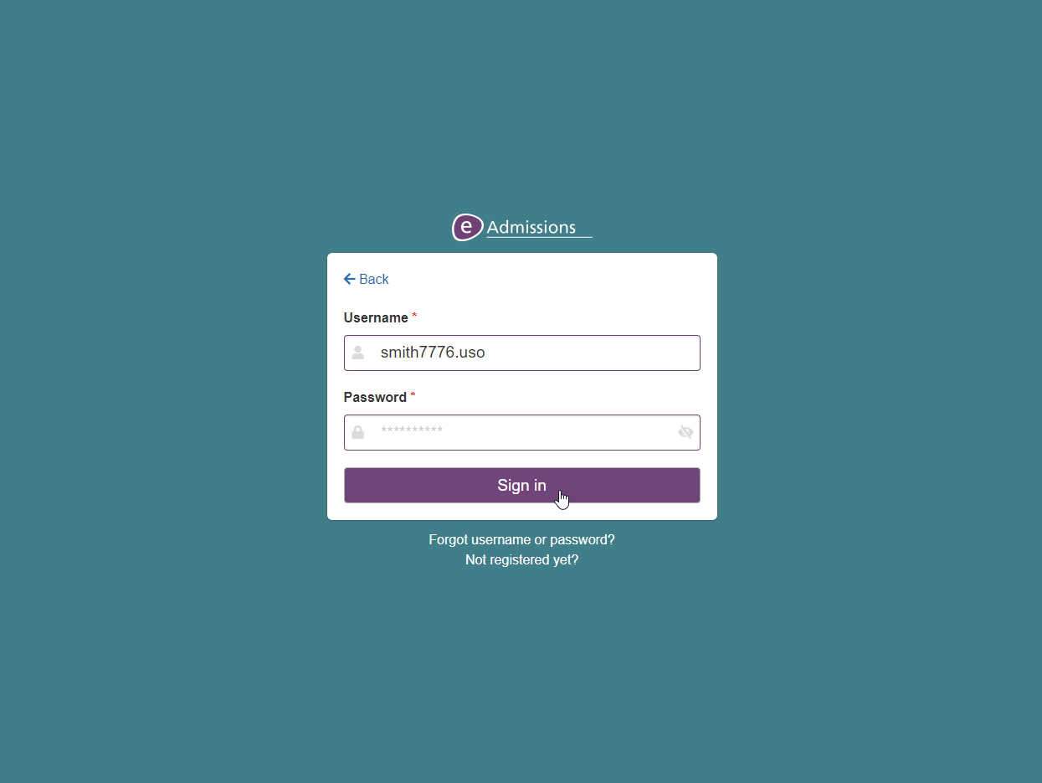
Reset 8
Please then enter your username and your password to log into your account.
Please note that after you have logged in, you will get the option to change the password that has been generated for you to something memorable.

